Slide 1
Key areas to address
Modernizing the application
Deploying application as independent microservices
Break-up existing monolithic core application
Manage data across microservices
AWS services
Incorporate frequent deployments
CI/CD on AWS
1

Slide 2
Modernizing the application
Modernizing means updating and transforming something to align with current trends, technologies, and standards. In the context of applications, it involves improving functionality, performance, user experience, and security through adopting modern architectures, leveraging cloud technologies, and implementing automation, among other measures. The aim is to ensure the application remains relevant and competitive in today's fast-paced technological landscape.
To modernize your application:
Assess and improve your architecture.
Consider migrating to the cloud and leveraging cloud services.
Adopt microservices and containerization.
Implement DevOps practices for faster development and deployment.
Enhance the user experience (UX) and optimize for mobile devices.
Explore data analytics and AI integration.
Prioritize security and privacy measures.
Optimize performance through caching and monitoring.
Continuously update and improve the application.

Slide 3
Deploying application as independent microservices
Deploying an application as independent microservices involves breaking down the application into smaller, self-contained services that can be developed, deployed, and scaled independently. Each microservice focuses on a specific function and communicates with other microservices through well-defined APIs. This approach offers benefits such as improved scalability, flexibility, and fault isolation
To deploy an application as independent microservices:
Identify services and their boundaries.
Design APIs for communication.
Containerize each microservice.
Use a container orchestration platform like Kubernetes.
Implement service discovery for seamless communication.
Manage data and persistence.
Ensure monitoring and security.
Establish CI/CD pipelines for automated deployment.

Slide 4
Break-up existing monolithic core application
Breaking up an existing monolithic core application involves decomposing the application into smaller, more manageable components or services. This process, known as application decomposition, aims to extract distinct functionalities from the monolith and create separate services or modules that can be developed, deployed, and scaled independently. By breaking up the monolith, you can achieve benefits such as increased agility, scalability, and maintainability

Slide 5
Monolithic Architecture
A monolithic architecture refers to a traditional software architecture where an entire application is built as a single, self-contained unit. In a monolithic application, all the components, modules, and functionalities are tightly coupled and run as a single process. The monolithic architecture is characterized by:
Complexity: Monolithic applications tend to be complex and difficult to understand, as all the logic and components are tightly integrated.
Scalability Challenges: Scaling a monolithic application can be challenging, as the entire application needs to be replicated and deployed.
Deployment and Maintenance: Deploying and maintaining monolithic applications can be time-consuming and risky, as any change or update affects the entire application.
Limited Technology Flexibility: In a monolithic architecture, it's challenging to adopt new technologies or frameworks, as any change requires modifying the entire application.

Slide 6

Monolithic 3-tier Application
Web servers
Presentation layers
Monolith
Application servers
Business logic
Database servers
Data layer
6

Slide 7
Microservices Architecture:
Microservices architecture, on the other hand, is an architectural style where an application is built as a collection of small, independent services. Each service focuses on a specific business capability and can be developed, deployed, and scaled independently. The microservices architecture is characterized by:
Modularity: Each service in a microservices architecture is modular, meaning it can be developed, tested, and deployed independently of other services.
Scalability and Resilience: Microservices can be scaled independently based on their specific demand, allowing for better resource utilization and resilience.
Technology Flexibility: Microservices architecture allows teams to choose different technologies and frameworks for each service, promoting flexibility and innovation.
Continuous Delivery: Microservices architecture aligns well with continuous delivery practices, enabling teams to deploy and update services independently, reducing deployment risks.

Slide 8
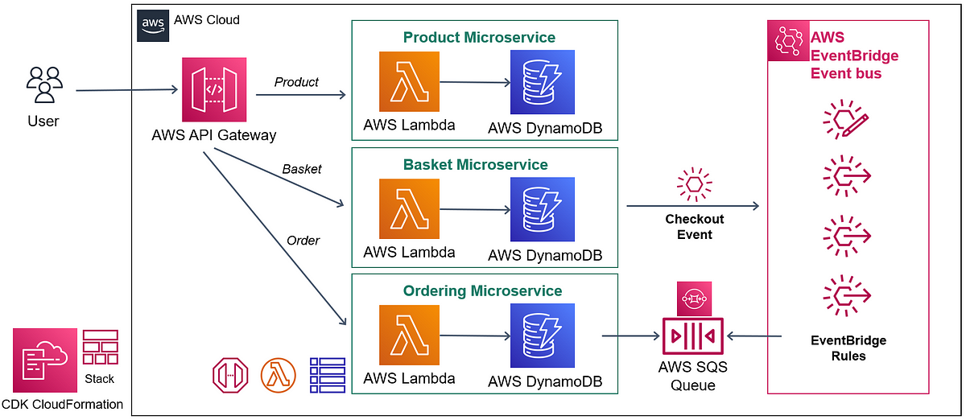
Microservices Architecture:

Slide 9
Microservices Development Lifecycle
Developers
Services
Delivery pipelines
build
test
deploy
monitor
build
test
deploy
monitor
build
test
deploy
monitor
build
test
deploy
monitor
build
test
deploy
monitor
build
test
deploy
monitor
9

Slide 10
Benefits of Microservices:
Agility: Microservices architecture enables faster development and deployment cycles, as teams can work independently on different services.
Scalability: Services can be scaled independently to handle varying workloads, optimizing resource usage.
Fault Isolation: A failure in one service does not affect the entire application, ensuring fault isolation and improved resilience.
Technology Diversity: Teams can choose the most suitable technology stack for each service, promoting innovation and using the right tools for specific requirements.

Slide 11
Manage data across microservices
Managing data across microservices involves various strategies such as using a database per service, employing event-driven architectures, implementing API-driven data access, utilizing data replication and caching, and adopting patterns like event sourcing and CQRS. Each approach has its benefits and considerations, addressing data independence, consistency, scalability, and performance in a distributed microservices environment.

Slide 12

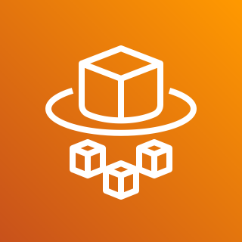

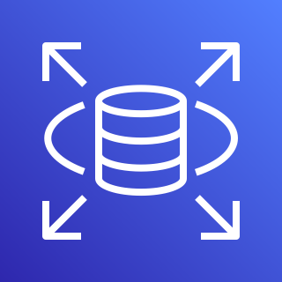
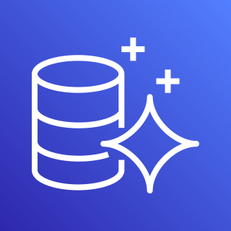

AWS Services
Amazon Elastic Container Service (Amazon ECS)
AWS Fargate
Amazon Simple Notification Service (Amazon SNS)
Amazon Relational Database Service (Amazon RDS)
Amazon Aurora
Amazon DynamoDB
12

Slide 13
AWS services
AWS (Amazon Web Services) offers a wide range of cloud services to support various computing, storage, networking, database, analytics, machine learning, and deployment needs. Here are some key AWS services:
Amazon EC2: Provides virtual servers in the cloud, offering scalable compute capacity.
Amazon S3: Offers scalable object storage for storing and retrieving data, such as files, images, and videos.
Amazon RDS: Provides managed relational databases, including options like MySQL, PostgreSQL, and Amazon Aurora.
Amazon DynamoDB: A fully managed NoSQL database service that delivers low-latency, high-performance storage for web, mobile, gaming, and IoT applications.
AWS Lambda: Enables serverless computing, allowing you to run code without provisioning or managing servers.
Amazon API Gateway: Manages and scales APIs, allowing you to create, publish, and monitor APIs for applications.

Slide 14
7.Amazon SNS: A fully managed messaging service for pub/sub and mobile push notifications.
8.Amazon SQS: Offers a fully managed message queuing service for decoupling and scaling microservices, distributed systems, and serverless applications.
9.Amazon VPC: Provides a virtual private cloud for secure and isolated networking resources in the AWS cloud.
10.Amazon CloudFront: A content delivery network (CDN) service that delivers data, videos, applications, and APIs globally with low latency and high transfer speeds.
11.AWS S3 Glacier: Provides long-term data archival and backup storage with retrieval options for data recovery.
12.Amazon Redshift: A fully managed data warehousing service that allows you to analyze large datasets and generate insights.
13.AWS CloudFormation: Enables infrastructure as code by automating the provisioning and management of AWS resources.
14.Amazon Elastic Beanstalk: Simplifies the deployment and management of applications by abstracting infrastructure details.
15.AWS IAM: Manages user identities and access control for AWS resources.

Slide 15
Incorporate frequent deployments
Incorporating frequent deployments refers to the practice of regularly releasing new versions or updates of software applications. It involves establishing processes and tools that allow for quick and efficient deployment of changes to production environments. The goal is to reduce the time between development cycles and make smaller, incremental updates to the application rather than infrequent, large-scale releases.
Frequent deployments offer several benefits, including:
Faster time to market: By deploying updates more frequently, organizations can deliver new features, bug fixes, and improvements to end-users faster, gaining a competitive edge.
Rapid feedback loop: Frequent deployments enable faster feedback from users, allowing teams to iterate and improve the application based on real-world usage and user feedback.
Reduced risk and smaller changes: With smaller, incremental changes, the impact of each deployment is reduced, making it easier to identify and rectify issues quickly. It also minimizes the risk of introducing large-scale bugs or disruptions.
Continuous improvement: Regular deployments encourage a culture of continuous improvement, where teams can learn from each deployment, gather data, and make data-driven decisions for future iterations.

Slide 16
CI/CD on AWS
Modernization with AWS CI/CD (Continuous Integration/Continuous Deployment) involves leveraging AWS services and tools to automate and streamline the software development and deployment processes. Here's how AWS CI/CD can contribute to modernization:
16

Slide 17





CI/CD on AWS
AWS CodePipeline
Source
Build
Test
Deploy
Monitor
AWS
CodeCommit
AWS
CodeBuild
AWS
CodeBuild
AWS
CodeDeploy
Amazon CloudWatch

Slide 18
Modernization with AWS CI/CD
Modernization with AWS CI/CD (Continuous Integration/Continuous Deployment) involves leveraging AWS services and tools to automate and streamline the software development and deployment processes. Here's how AWS CI/CD can contribute to modernization:
AWS CI/CD enables modernization by automating and streamlining software development and deployment. Services like Code Pipeline , Code Build, and Code Deploy automate the release process. CloudFormation provides infrastructure as code, Elastic Beanstalk simplifies deployment, and Lambda enables serverless computing. With AWS CI/CD, organizations achieve faster, reliable, and scalable deployments, facilitating modernization efforts.

Slide 19
Define what makes up a service
Functionality: A service provides a specific set of functions or capabilities to fulfill a particular purpose or address a specific need. It defines the features and operations it offers to its users.
Interface: A service exposes an interface or API (Application Programming Interface) that defines how users can interact with and access its functionality. The interface specifies the methods, parameters, and protocols to communicate with the service.
Independence: A service is designed to be independent and self-contained. It can operate autonomously without being tightly coupled to other services or components. This enables flexibility, scalability, and modularization within a system or architecture.
Reusability: Services are often designed to be reusable, meaning they can be utilized by multiple applications or systems. This promotes code sharing, reduces duplication, and improves efficiency in development.
Encapsulation: Services encapsulate their implementation details, hiding the internal workings and complexity from users. This allows users to interact with the service without needing knowledge of its internal mechanisms, promoting abstraction and simplicity.
Notes:
Some of the benefits of microservices Small independent teams - own pace, fully responsible (development, staging, and production)
Reduced complexity
Smaller easy deployment and failure isolation
Faster feedback loop
Freedom to choose and replace technology stack
Individual scaling
Accelerate time to market
Resilient
Container is a piece of software that packages the application code and all the dependencies needed to run that application.
API - API stands for Application Programming Interface. APIs are mechanisms that enable two software components to communicate with each other using a set of definitions and protocols.

Slide 20
6.Availability: A service is expected to be available for use whenever needed, providing reliable and consistent access to its functionality. It should be designed to handle high loads, be resilient to failures, and have appropriate measures in place to ensure uptime.
7.Security: Services should incorporate security measures to protect data and resources. This includes authentication, authorization, encryption, and other security mechanisms to safeguard sensitive information and prevent unauthorized access.
8.Governance: Services may have governance mechanisms in place to manage their lifecycle, versioning, documentation, and policies. This helps ensure consistency, maintainability, and compliance with organizational guidelines or industry standards.
9.Scalability: Services should be designed to handle varying workloads and be able to scale horizontally or vertically based on demand. This allows them to accommodate increased usage or changing requirements without sacrificing performance.

Slide 21
AnyCompany Migration:
On-premises to AWS migration refers to the process of moving an organization's existing applications, data, and infrastructure from an on-premises environment to the cloud-based infrastructure provided by Amazon Web Services (AWS). This migration offers several benefits, including scalability, flexibility, cost savings, and access to a wide range of AWS services.

Slide 22
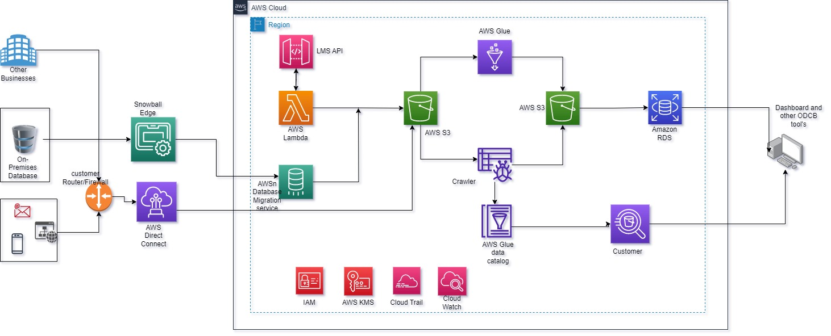
AnyCompany Migration:
Proposed Architecture:

Slide 23
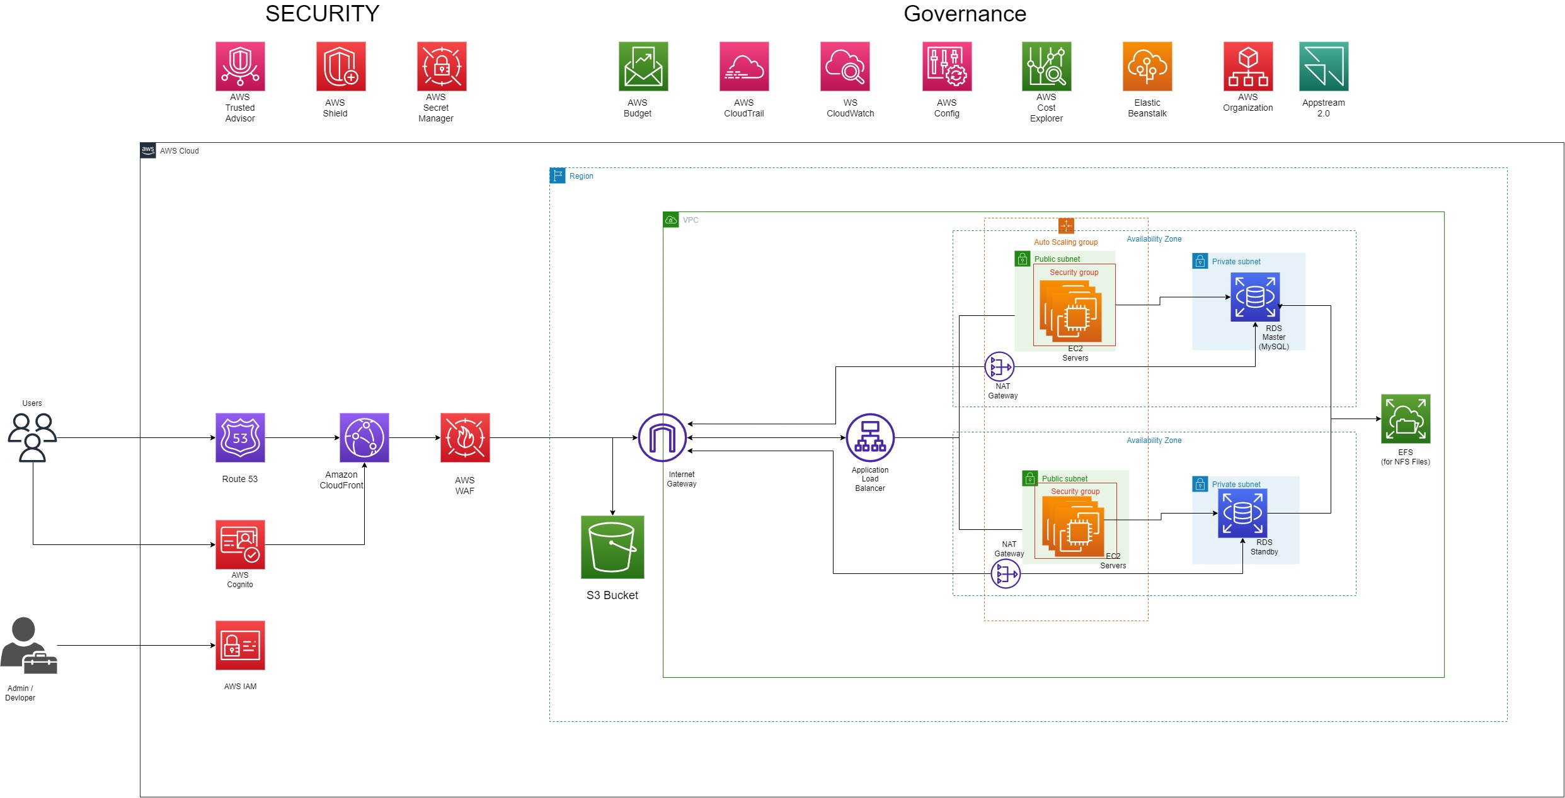

Slide 24
Here are some key steps involved in an on-premises to AWS migration:
Assessment and Planning: Evaluate the existing on-premises infrastructure, applications, and data to determine the feasibility and requirements for migration. Identify the dependencies, performance considerations, and any potential challenges.
Designing the AWS Architecture: Develop an architecture and migration plan that aligns with the organization's goals and requirements. Determine the appropriate AWS services, such as EC2 instances, VPC, S3, RDS, or Lambda, to meet the needs of the applications and workloads.
Data Migration: Transfer data from on-premises systems to AWS storage services, such as Amazon S3 or Amazon EBS. This can be done through various methods like using AWS DataSync, AWS Snowball, or establishing a direct connection through AWS Direct Connect.
Application Migration: Determine the migration approach for each application. This may involve rehosting (lift-and-shift), refactoring, or rebuilding the application using AWS services. Rehosting involves moving the application as is to AWS infrastructure, while refactoring and rebuilding involve making architectural or code changes to optimize for AWS services.

Slide 25
5.Networking and Connectivity: Establish connectivity between the on-premises environment and AWS using options like AWS Direct Connect or VPN (Virtual Private Network). This ensures secure communication and seamless integration between the two environments.
6.Testing and Validation: Conduct thorough testing of the migrated applications and infrastructure to ensure they function as expected. Perform performance testing, security testing, and validate data integrity to identify and resolve any issues.
7.Cut-Over and Go-Live: Plan and execute the cut-over from the on-premises environment to AWS. This may involve scheduling downtime, DNS updates, or implementing load balancers to redirect traffic to the migrated environment. Monitor the system closely during this transition period to address any issues promptly.
8.Optimization and Management: Once migrated, optimize the AWS environment for performance, cost, and security. Leverage AWS monitoring and management services like CloudWatch and AWS Trusted Advisor to monitor resource utilization, performance metrics, and implement best practices.

Slide 26
Migrating to Amazon Web Services (AWS) offers several benefits for organizations:
Scalability: AWS provides virtually unlimited scalability, allowing organizations to easily scale up or down based on demand. This ensures that applications can handle increased traffic or workload without disruptions, providing a better user experience.
Flexibility: AWS offers a wide range of services and solutions to meet various application and infrastructure needs. Organizations can choose from a vast selection of compute, storage, database, networking, and other services, tailoring their solutions to specific requirements.
Cost Savings: AWS follows a pay-as-you-go pricing model, enabling organizations to pay only for the resources they use. This eliminates the need for large upfront investments in hardware and infrastructure. Additionally, AWS provides cost optimization tools and services to help organizations optimize their spending and reduce overall costs.
Reliability and Resilience: AWS operates a highly reliable and resilient infrastructure. With multiple availability zones, data centers, and redundant systems, AWS ensures high availability and fault tolerance. This reduces the risk of downtime and data loss, providing a robust foundation for critical applications.

Slide 27
6.Global Reach: AWS operates in multiple geographic regions worldwide, allowing organizations to deploy their applications closer to their users. This reduces latency, improves performance, and enables compliance with local data regulations.
7.Innovation and Agility: AWS provides a wide array of innovative services and solutions, such as AI/ML capabilities, IoT services, serverless computing, and containerization. These technologies enable organizations to embrace innovation, accelerate development cycles, and deliver new features and functionalities to market faster.
8.Operational Excellence: AWS offers a suite of management and monitoring tools, including AWS CloudFormation, AWS CloudWatch, and AWS Trusted Advisor. These tools assist in managing, monitoring, and optimizing AWS resources, improving operational efficiency and performance.
9.Disaster Recovery and Backup: AWS provides disaster recovery and backup solutions that allow organizations to replicate their data and applications across different regions for business continuity. This ensures that critical data and systems are protected and can be quickly restored in the event of a disaster.

Slide 28

Proposed Architecture
Website
Order Processing Logic
Amazon Elastic Container Service (Amazon ECS)
Amazon EC2
AWS Fargate
Web UI
User Authentication
Order Processing
Payment Processing
Notification
Database Options
Notification
Amazon Aurora
Amazon RDS
Amazon DynamoDB
Amazon SNS
28

Slide 29
AWS: Shared Responsibility Model
AWS manages
Customer manages
AWS Lambda
Physical hardware, software, networking, and facilities
Provisioning
Application code
AWS Fargate
Container orchestration and provisioning
Physical hardware, host OS/kernel, networking, and facilities
Application code
Security config and updates
Network config
Management tasks
Amazon ECS/EKS
Physical hardware software, networking, and facilities
Application code
Security config and updates
Network config
Application code
Scaling
Security config and updates
Provisioning, managing scaling and patching of servers
Amazon EC2
Physical hardware software, networking, and facilities
29

Slide 30
Things to keep in mind?
Value to business
Role in addressing customer experience
Analyzing the application (full application assessment)
Ease or difficulty of modernizing

Slide 31
Traditional Development Lifecycle
Developers
Service
Delivery pipelines
build
test
release
monitor
31

Slide 32

AnyCompany Questions
How do we define what makes up a service?
How do we manage data across service boundaries?
What AWS services should we use for each service?
How do we make deployments that are more frequent to each service?
32

Slide 33
ONE QUESTION STILL LEFT?
33

Slide 34
COST
ONE QUESTION STILL LEFT?
34

Slide 35
Next Steps
Any specific questions?
What we can offer
Expert Session
Immersion days
Follow Up Email
Summary
Suggested Links
Reach out to us
35

